Slide 1


Mark DeMarco MSM,CFM
Senior Manager, WDW
President: LifeSafetyMD
Bringing 25+ Years of Fire Safety Leadership: Mark is a trusted expert in fire codes, alarm and protection systems, and emergency management—blending real-world knowledge with an unwavering passion for public safety.
A Fire Safety Trailblazer: From teaching fire science as an Adjunct Professor to holding credentials as a Fire Safety Inspector II, Life Safety Educator, Plans Examiner, Certified Facility Manager (CFM), and earning a Master’s in Emergency Management
Driven by Purpose, Powered by Experience: Mark’s mission is clear—empower the next generation of fire safety professionals by passing on decades of wisdom, insight, and dedication to keeping people and property safe.

Slide 2


Slide 3


Slide 4

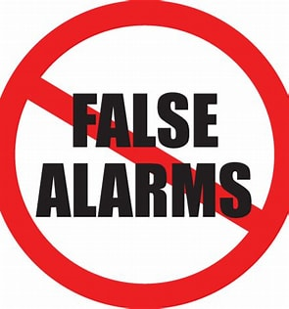

Slide 5
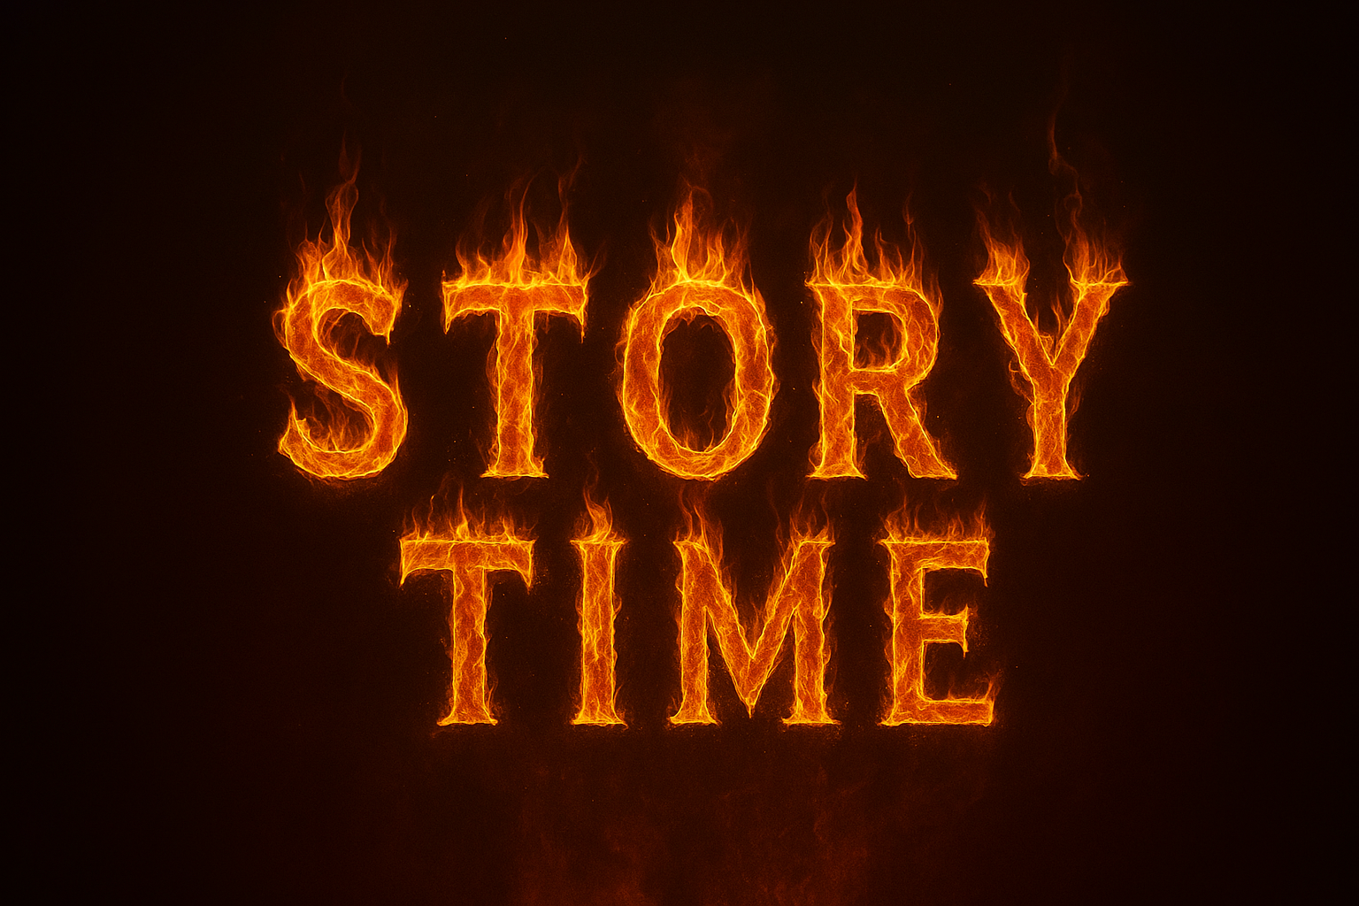
Notes:
Engagement/Airport/Stepdaughter)

Slide 6
NO Such Thing as a False Alarm
NFPA 72: National Fire Alarm and Signaling Code (2019)
3.3.105 False Alarm. Refers you to 3.3.314
  Unintentional Alarm.
  Unknown Alarm.
  Unwanted Alarm.
  Malicious Alarm.
  Nuisance Alarm.

Slide 7
Cutting-Grinding Sanding-Sweeping
Pressure Washing
Smoking/Vaping
Welding/Soldering
Sprinkler System Filling-Draining Broken Head
Fire Alarm Control Panel
Horns
Strobes
AC Shutdown
Elevator Recalls
Fire Door Closures
Business STOPS
Smoke Control Activation

Slide 8
Net Effect(s) of Nuisance Fire Alarm Activation
Disruptions in Business Continuity
Hotel Evacuation
Attraction/Ride Evacuation
Restaurant Evacuation
Complacency
Production STOPS

Slide 9
How much does it cost YOUR Business?

Slide 10
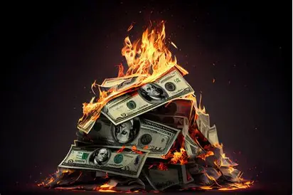
Statistical Costs
3500 Non-Heat Events in a local County (MATH = 10/day)
Estimated Nearly 3,000,000 in the US alone…That’s nearly 3 Million (COPILOT)!
  Wear and Tear on Trucks? Fuel?
  Risk of Accidents (emergency vehicles or POV’s)
  Reallocation of Labor (at facility and responding to incident)
  Comp nights? Meals? Production in assembly lines? Distribution Warehouses?
  $1,000 per incident (conservative)
  3M x $1,000 = $3B/annually… $3,000,000,000 (lots of zeros)

Slide 11

What Can YOU Do?

Slide 12

The Metrics That Matter:
Notes:
Develop and maintain a Dashboard (Smartsheets, Spreadsheets, Power apps)

Slide 13


Collect DATA! Let Data Tell the Story!
Data IS the Driver – Let YOUR Facility Tell Its Story. But How? Dashboard?
Generalize First! Then Root Cause Analysis
Construction Operations
Maintenance Operations
Cooking Operations
Custodial
Mischievousness
System Malfunction/Deterioration
Lack of Proper Maintenance?
NOT THIS DATA

Slide 14
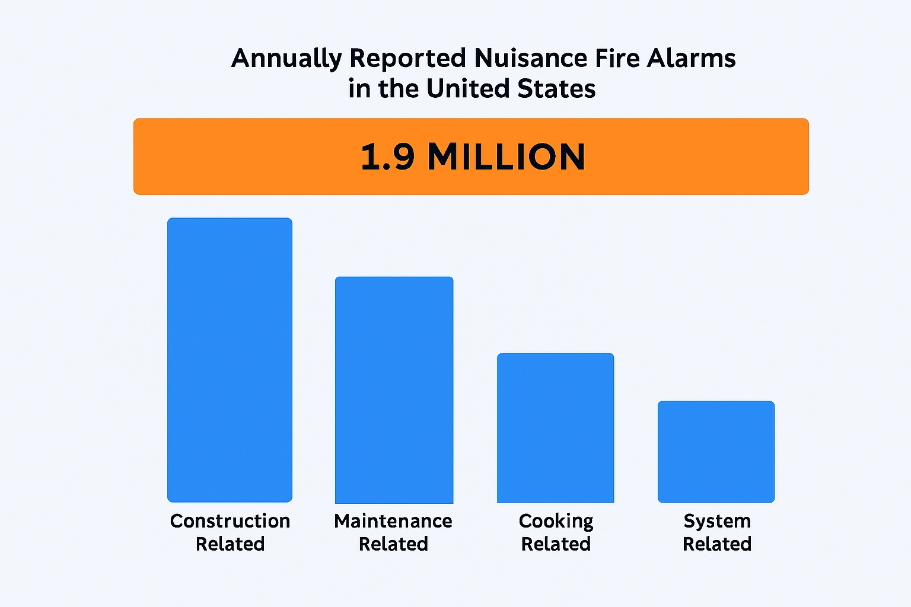
Your DATA
Notes:
Quarterly look-backs with Leadership. Target costly areas. Develop a message. Explain the WHY’s. Resort costs: actual. Not to brow beat, but to raise awareness to change processes and behaviors.

Slide 15

Trail of Transparency – Accountability with Data
Who, What, When, Where Tracking – Drives opportunity, ownership, and trust
Oversight Framework: Stop, Start, Continue philosophy (30, 60, 90 days)
Transparency creates actionable insights
Stakeholder Engagement in Prioritization
Opportunity cost discussion fosters collaboration
Notes:
Don’t be afraid to test the waters! Stop, start, continue philosophy.
Honesty! Rules: Only those that do NOTHING, make no Mistakes! Builds trust.

Slide 16
From Data to Direction – Strategic Planning for the Future
Education Raises AWARENESS. AWARENESS Changes BEHAVIORS
  Evaluate Construction Processes (NFPA 241 implementation)
  Fire Prevention Classes: Onsite/Online (Prior to any work)
  Maintenance Processes (Welding, Drywall-ing, Dusting, Comms)
  Partnership(s) with AHJ (Not a Four-Letter Word!) Burn Permit?
  Obsolescence? Dated Systems?
  System Capabilities (Addressable/PAS/Alarm Verification/ASD)
  UL 268 7th Edition + Upgrades?
  TIM Tools (how much smoke is too much?) to Standardize
  Spare Tire Analogy!
Notes:
Advancements in Technology: ASD’s, UL268 8th Edition Smokes, Self Adjusting Beam Detectors, Alarm Verification, PAS. VOICE announcements

Slide 17
Call to ACTION: Rethinking the Investment
Change the Way We Think – Compare upfront costs with long-term savings.
Stakeholders: Consultants, AHJ, Trades, Finance, Vendor, FM(s)
  Fire Alarm Type – System Differences (Voice/Horns/Addressable)
  Maintenance Friendly (Disabling/Enabling/Canned Messages/Self-Diagnostics, Self-adjusting, pre-alerts.
  Recovery Friendly (System Life Cycle, Sustainment, Backwards Compatible)
  Business Friendly for future growth?
  Relationship(s) with Manufacturer (Stakeholder? Yes?)

Slide 18

All In: Collaboration from Day One Starts Today!
Be Part of the Process – Get all stakeholders involved early.
Initial Planning, Oversight, and Vision – Build a roadmap everyone understands.
Harnessing Construction Practices to Plan for Success – Reinforce NFPA 241 principles with every buildout: project conception to commissioning.
Nuisance Alarm Avoidance Plan! Put it in writing!

Slide 19

Risk, Liability & Maintenance Enforcement
Threats grow with poor maintenance and outdated systems
Code requires regular maintenance, inspection, and testing
Neglect increases assumed liabilities and risks (Spare Tire)
Strong AHJ relationships support compliance and risk reduction
Notes:
AHJ relationships: How many AHJ’s in audience? AHJ is not a four letter word! Use them!

Slide 20
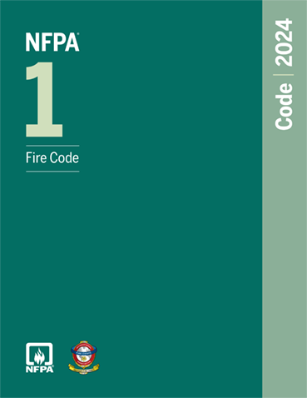
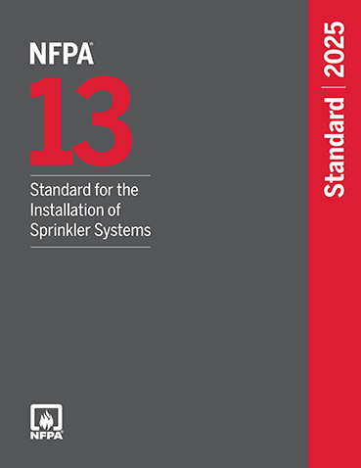

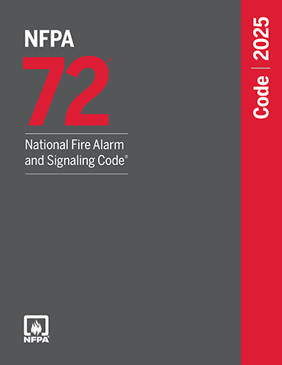
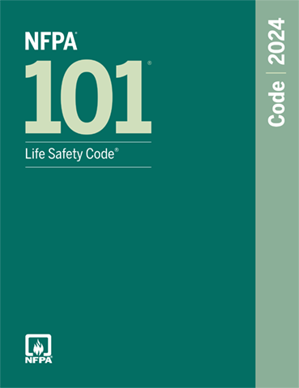

HOW IMPORTANT IS MAINTENANCE?
474
170
231
223
390
Notes:
Maintain!!! Use the spare tire in the trunk analogy. Fire safety should not take a backseat.

Slide 21
THANK YOU!!!!
Questions? Comments?
We can make a difference!
mark@LifeSafetyMD.com

